Slide 1
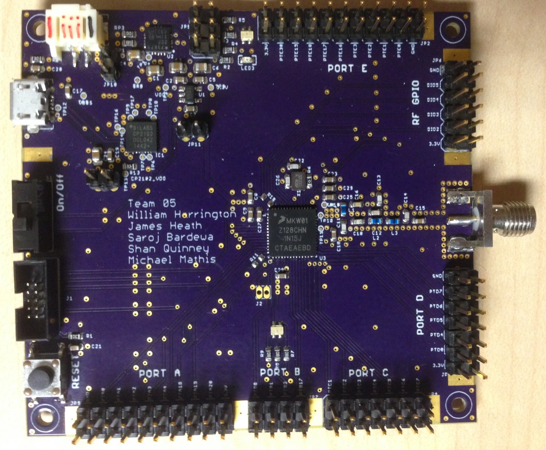

CubeSat C3 Board
(Command, Control and Communication)
Team: T05
William Harrington
James Heath
Shan Quinney
Michael Mathis
Saroj Bardewa

Slide 2
Outline
Project Description
Motivation
Implementation
Results
Demo

Slide 3
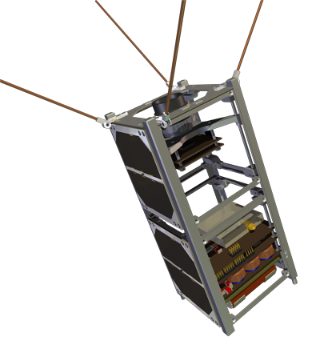
Problem
PSAS’s mission to get a CubeSat into
Lower Earth Orbit
Need for a device for command,
control and communication (C3)
between a CubeSat and a ground station
Board with specific functionalities and
broadcast Frequency (436.5 MHz)
Notes:
Problem or Need : What is the problem being solved? Where does it arise?
→ Portland State Aerospace Society has a need of a device that can communication between a CubeSat and a ground Station. The commercial Boards

Slide 4
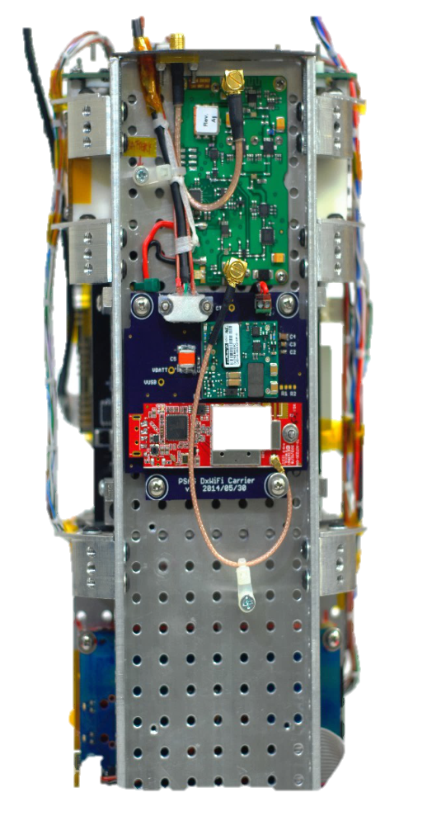
Motivation
Take a small part in PSAS’s
CubSat Mission
Objective: Prototype a device to meet
the specifications
Notes:
Motivation: Why is it important? What is the value of a solution?
→Andrew solicited the class to build a system with his specifications

Slide 5
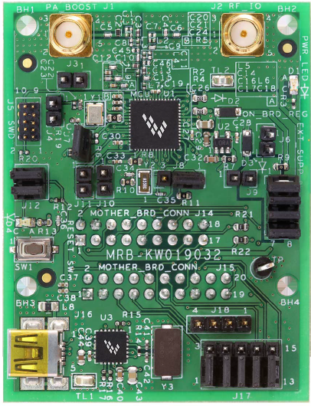
Alternative
Notes:
What other alternatives exists?
→ MRB-KW0x board, but it does not meet the frequency needs and other limitations

Slide 6
Requirements
Must:
Be a breakout board
Have a transceiver for RF communications
Have a visible indication of communication
Have an antenna capable of 435-438 MHz frequency band transmission
Able to fit within CubeSat form factor (no bigger than (10cm x 10cm x 10cm)
Have access to UART, I2C,SPI,GPIO and ADCs/DACs

Slide 7
Requirements
Should:
Use USB interfacing
Be able to send/receive data packets via RF communication
Be battery powered
May:
Be capable of long distance communication
Be capable of sending/receiving data packets
Be capable of operation in space temperature range (-30C to 60C)

Slide 8

Acknowledgments
Portland State University
Aerospace Society (PSAS)
Theo Hill of PSAS

